Slide 1

Data 201
Capstone
Abu Naim Md Galib

Slide 2
Data 201 Capstone
The focus is on Identity Theft in New York City using historical NYPD data from 2006 to April 2025. Does this data align with the Federal Trade Commission’s (“FTC”) national or metropolitan regional average?
The dataset is 5.99 million rows and 19 columns.
My interest is two-fold; I am a Certified Fraud Examiner (“CFE”) and I have had to file my own fraud claims, specifically, in the summer of 2020, when someone filed a fraudulent unemployment claim in my name.

Slide 3
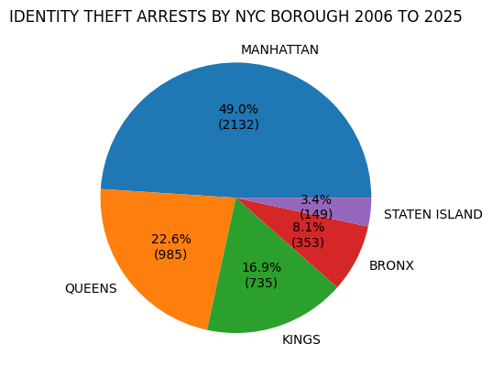
Primary findings
Almost half of the Identity Theft Arrests in New York City occurred in the Borough of Manhattan.
Black males were arrested at a rate of almost three times that of other races.
While other arrest categories continued to be reported by the NYPD through April 2025, Identity Theft no longer appeared after December 2018.

Slide 4
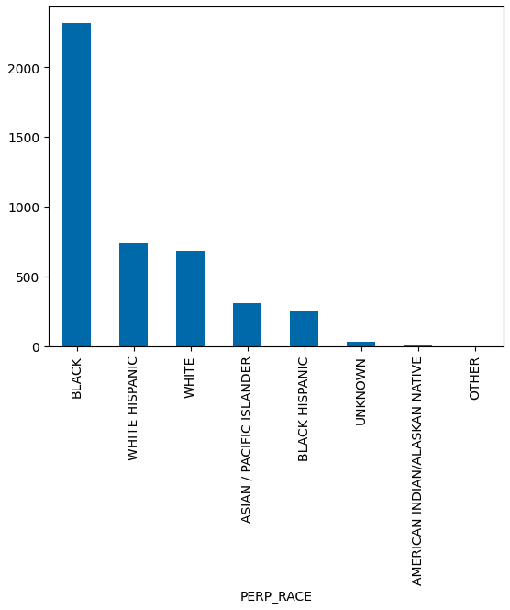
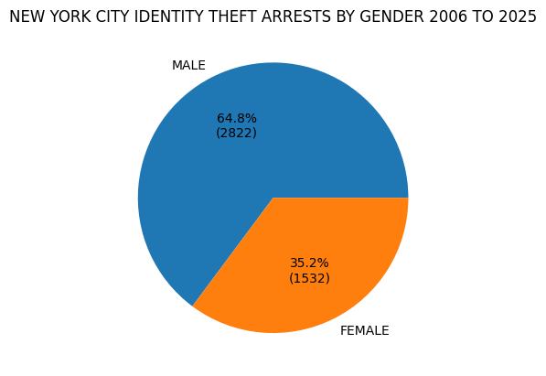
NYC identity theft Arrests by race and gender

Slide 5
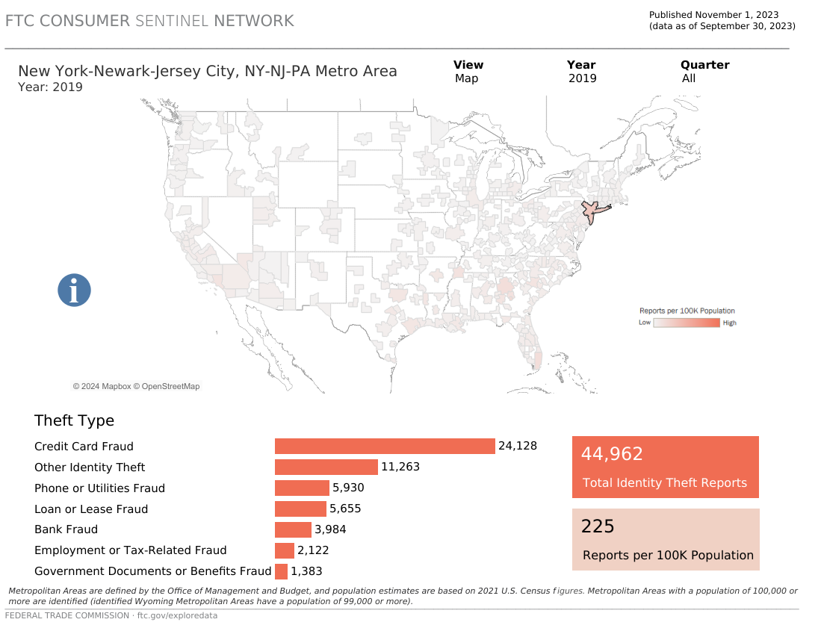
FTC 2019 NY Metro ID Theft average*

Slide 6
Summary
The NYPD Identity Theft reporting ended in 2018 and did not mirror what was being reported by the FTC.
The FTC reported that in 2019, the year after NYPD stopped reporting the category, Identity Theft had occurred in the New York City Metropolitan Area at an annual rate of 225 instances for every 100K in population (Average NYC population is 8,000,000 : 225 x 80 = 18,000 yearly average occurrences in NYC ).
The NYPD Historical Data disclosed 4,354 Identity Theft arrests between 2006 and 2018. The FTC data includes other types of fraud, and the NYPD data may have been mislabeled and/or was captured elsewhere.
Libraries: Pandas, NumPy, Matplotlib
Data Cleaning: Dropped unnecessary column; Replaced null/NaN data; Assigned DateTime value to column
Wrangling: New data frames; Renamed column headers; Filtered by string contains
Visualizations: Bar and Pie Charts

Slide 7
References
https://data.cityofnewyork.us/Public-Safety/NYPD-Arrests-Data-Historic-/8h9b-rp9u
*https://public.tableau.com/app/profile/federal.trade.commission/viz/FraudandIDTheftMaps/FraudbyMetroArea
https://www.ic3.gov/Media/PDF/AnnualReport/2022_IC3Report.pdf
https://identitytheft.org/statistics/

